Slide 1
Pneumonia Detection From Chest X-Rays Using Deep Learning
Automated diagnosis through advanced neural network methods
Carson Ivey
Notes:
AI-generated content may be incorrect. --- This presentation introduces our final project for the Deep Learning course, focusing on automated pneumonia detection from chest X-rays using deep learning techniques.

Slide 2
Problem Statement and Motivation
Notes:
This section outlines the challenges in manual pneumonia diagnosis using chest X-rays and motivates the need for automated solutions using deep learning.

Slide 3
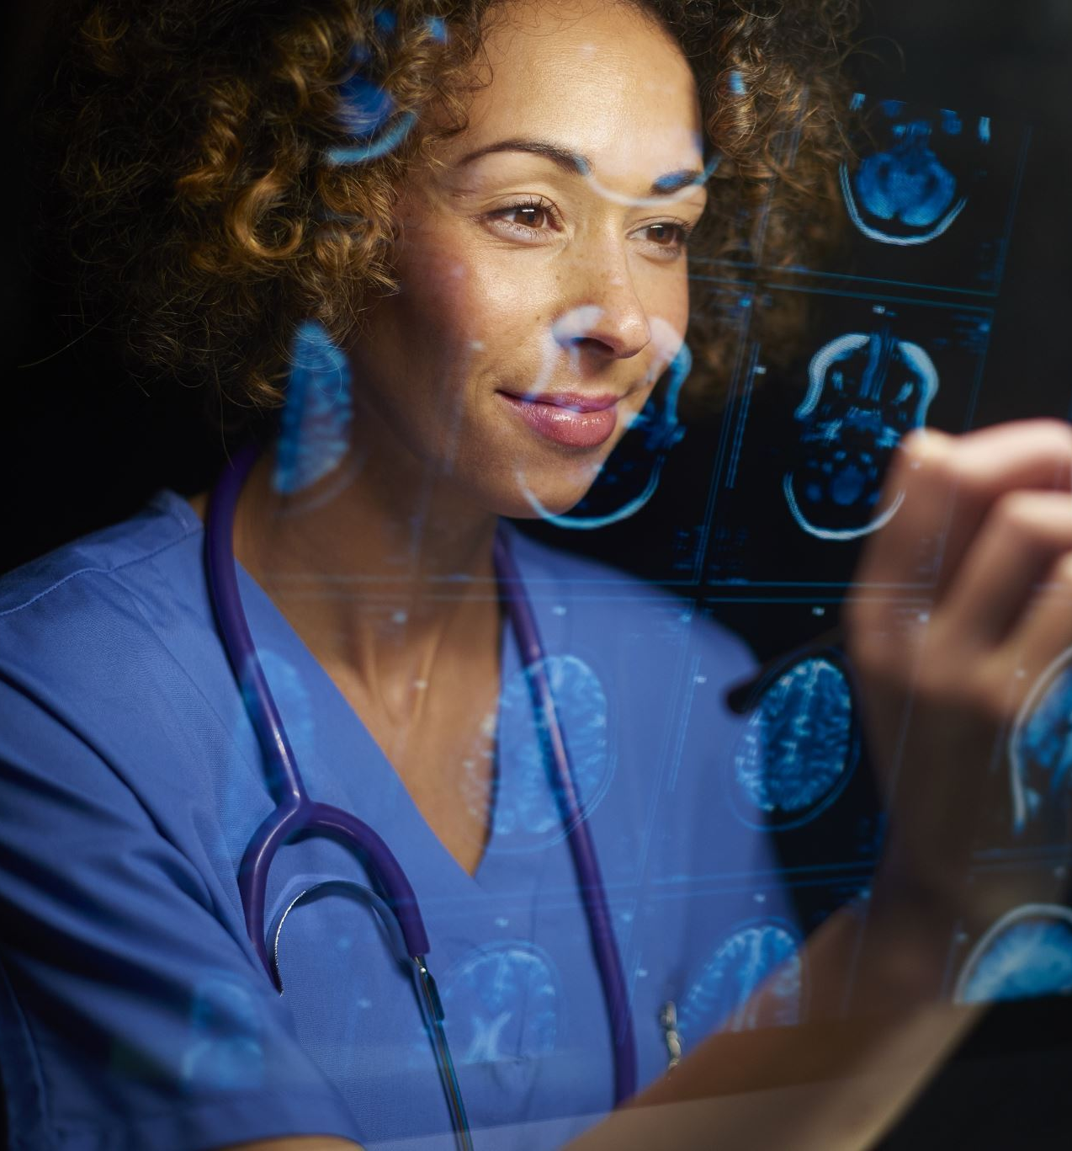
Challenges of Manual Pneumonia Diagnosis From X-Rays
Time-Consuming Process
Manual analysis of chest X-rays requires significant time, delaying diagnosis and treatment decisions.
Human Error Risk
Diagnosis depends on expert interpretation, which can be prone to errors and inconsistencies.
Variability in Results
Different radiologists may interpret the same X-ray differently, affecting diagnosis reliability.
Notes:
--- Manual diagnosis is time-consuming and prone to human error, often requiring expert radiologists and leading to variability in results. Image source: Microsoft 365 content library

Slide 4
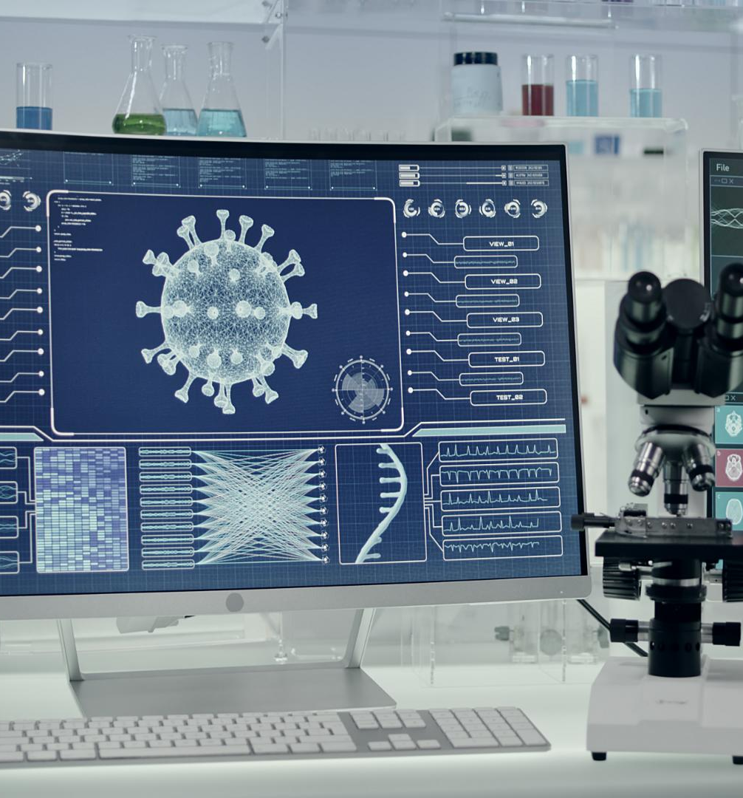
Goal of Automation Through Deep Learning
Automation Objective
The goal is to create an automated system that enhances pneumonia detection accuracy and efficiency.
Role of Deep Learning
Deep learning techniques enable the system to learn patterns and improve detection performance over time.
Improving Accessibility
Automation makes pneumonia detection more accessible, allowing faster diagnosis in diverse healthcare settings.
Notes:
--- We aim to develop an automated system using deep learning to improve pneumonia detection accuracy, efficiency, and accessibility. Image source: Microsoft 365 content library

Slide 5
Dataset and Exploratory Data Analysis
Notes:
This section discusses the dataset used and presents exploratory data analysis including dataset size, class distribution, and image characteristics.

Slide 6
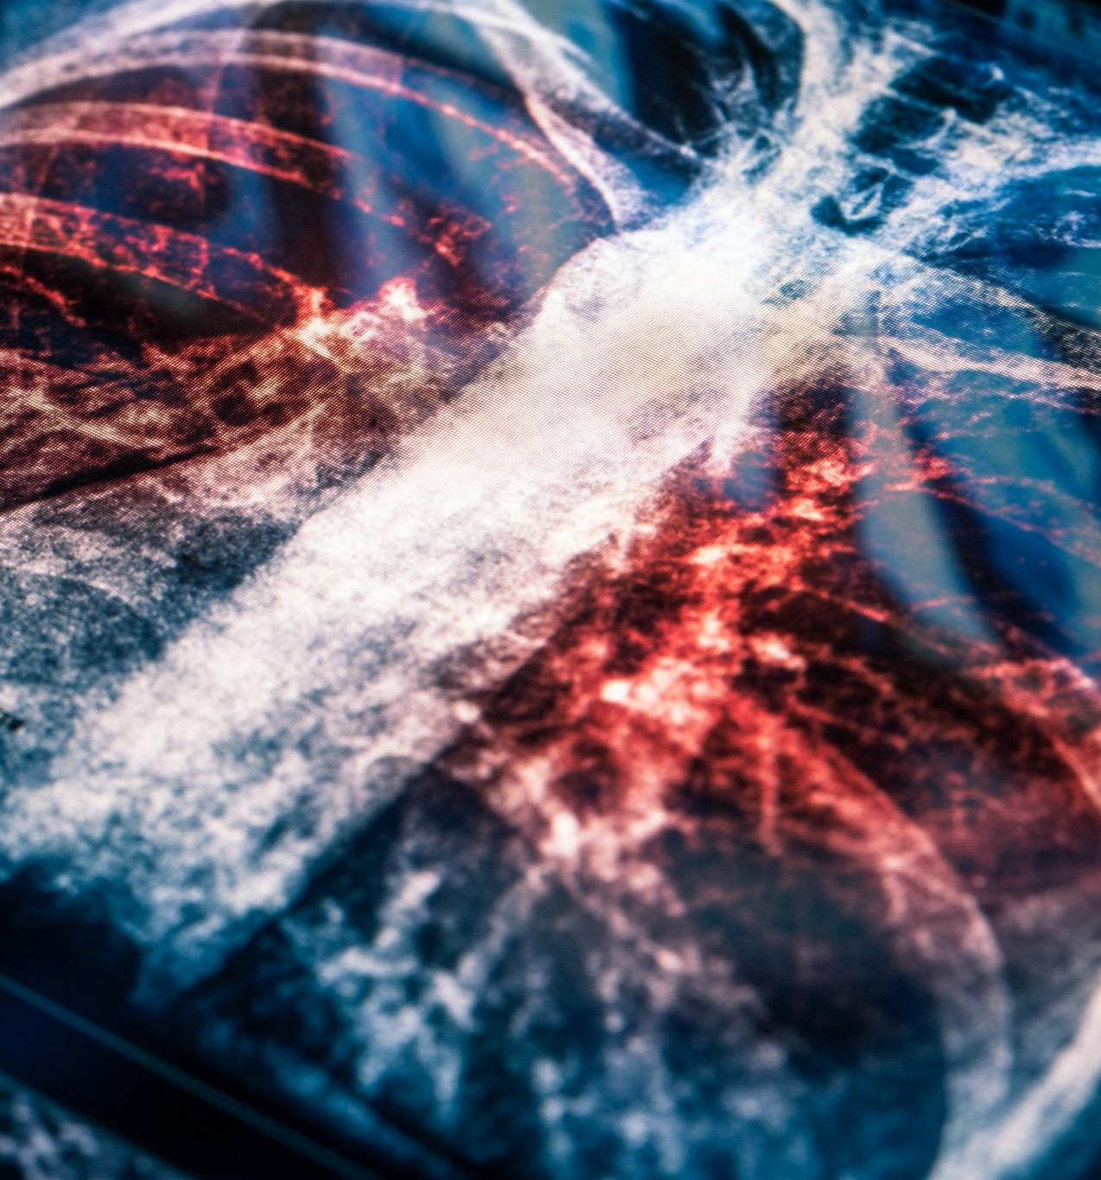
Kaggle Chest X-Ray Dataset Overview (Size, Classes)
Dataset Composition
The dataset consists of labeled chest X-ray images categorized into pneumonia and normal classes for reliable model training.
Purpose of Dataset
This dataset provides a strong foundation for training machine learning models to detect pneumonia from chest X-rays.
Notes:
--- We use the Kaggle chest X-ray dataset which contains labeled images divided into pneumonia and normal classes, providing a solid basis for training our model. Image source: Microsoft 365 content library

Slide 7
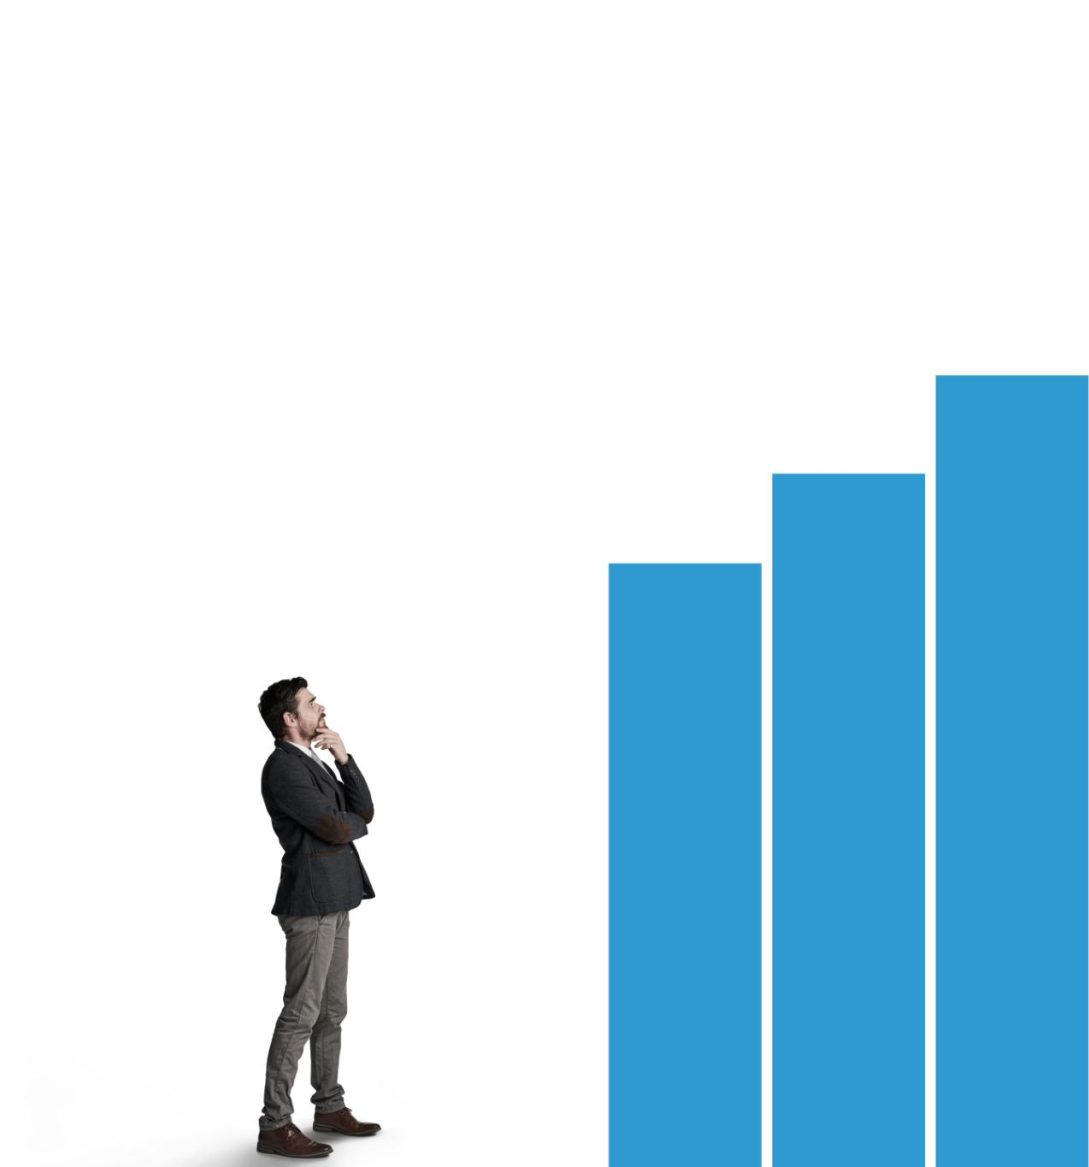
Class Imbalance in Dataset
Definition of Class Imbalance
Class imbalance occurs when certain classes are underrepresented compared to others in a dataset.
Impact on Model Training
Imbalanced data can bias models towards majority classes, reducing accuracy on minority classes.
Need for Careful Consideration
Addressing class imbalance requires techniques like resampling or algorithm adjustments during model development.
Notes:
--- The dataset exhibits class imbalance, which can affect training and model performance, requiring careful consideration during model development. Image source: Microsoft 365 content library

Slide 8
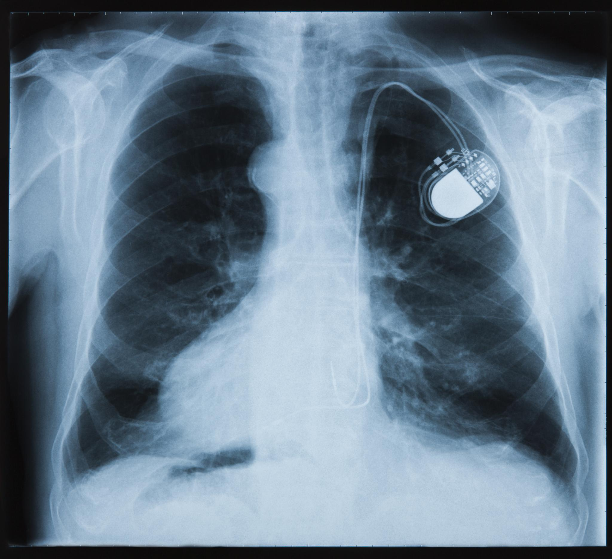
Visual Differences in Sample Images
Healthy Lung Characteristics
Normal chest X-rays display clear lung fields with no signs of infection or abnormalities.
Pneumonia Indicators
Pneumonia-affected lungs show visible opacities and infiltrates indicating infection in X-ray images.
Notes:
--- Sample chest X-ray images show visible differences between pneumonia-affected and normal lungs, which the model learns to detect. Image source: Microsoft 365 content library

Slide 9
Deep Learning Model and Training Setup
Notes:
Here we explain the deep learning architecture used and the training setup including hyperparameters and optimization details.

Slide 10
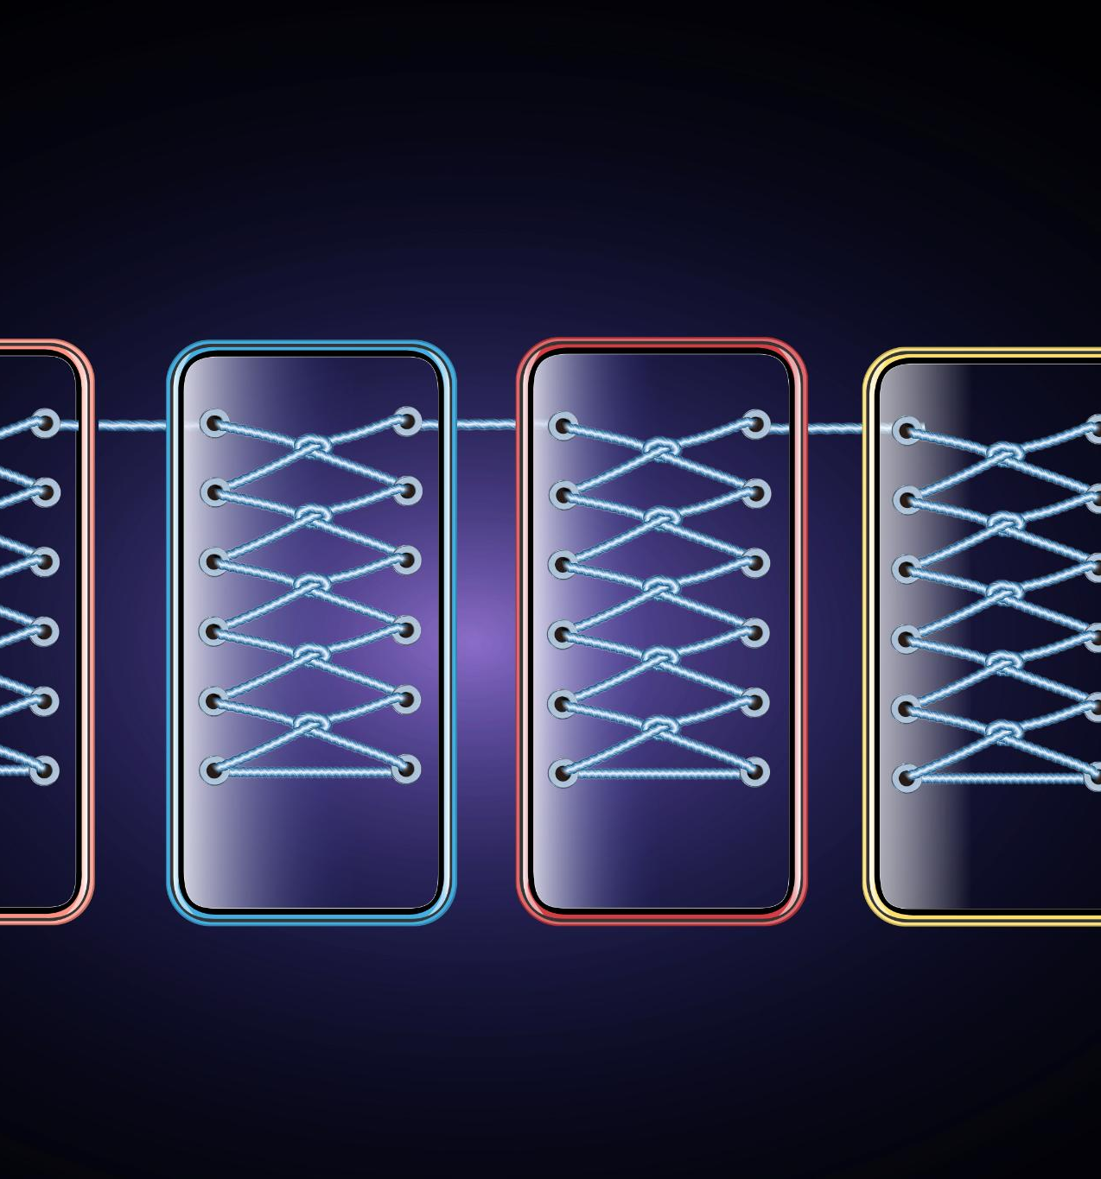
ResNet18 CNN Architecture (No Pretrained Weights)
ResNet18 Architecture
ResNet18 is a deep convolutional neural network architecture known for its residual learning framework.
Training from Scratch
The network is trained from scratch without pretrained weights to specialize in pneumonia detection.
Pneumonia Detection Task
Using a customized ResNet18 model helps improve accuracy in detecting pneumonia from medical images.
Notes:
--- We employ a ResNet18 convolutional neural network trained from scratch without pretrained weights to adapt fully to the pneumonia detection task. Image source: Microsoft 365 content library

Slide 11
Training Settings: Epochs, Batch Size, Optimizer, Loss
Epochs
Epochs define the number of complete passes through the training dataset during model training.
Batch Size
Batch size determines how many samples are processed before the model's internal parameters are updated.
Optimizer Choice
Optimizers control how the model learns by adjusting weights to minimize loss during training.
Loss Function
Loss function measures the discrepancy between predicted outputs and true labels to guide training.
Notes:
--- Training was performed using specific settings including number of epochs, batch size, optimizer choice, and loss function tailored for classification. Image source: Microsoft 365 content library

Slide 12
Model Performance and Evaluation
Notes:
This section presents the evaluation results of the trained model using accuracy, confusion matrix, classification report, and a live inference demo.

Slide 13
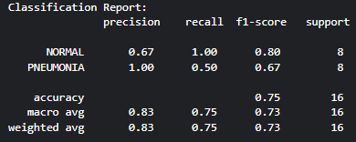
Validation Accuracy (75%)
Model Performance
The model achieved a validation accuracy of 75%, showing moderate effectiveness in classification.
Pneumonia Detection
The model differentiates pneumonia from normal chest X-rays based on learned features.
Notes:
--- The model achieved a validation accuracy of 75%, indicating moderate success in differentiating pneumonia from normal X-rays. Image source: Microsoft 365 content library

Slide 14
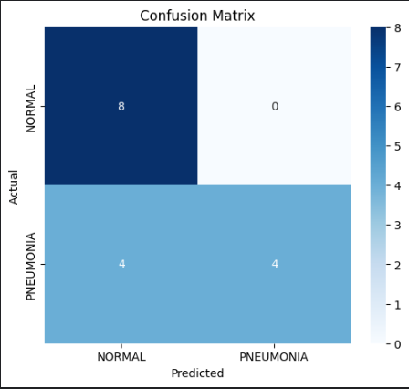
Confusion Matrix and Classification Report
Confusion Matrix Overview
The confusion matrix provides a visual summary of prediction results, highlighting true and false classifications.
Classification Report Metrics
The classification report details key metrics like precision, recall, and F1-score to evaluate model performance.
Model Strengths and Weaknesses
These metrics help identify where the model performs well and areas needing improvement for better accuracy.
Notes:
--- Detailed metrics including confusion matrix and classification report illustrate the model's strengths and areas for improvement. Image source: Microsoft 365 content library

Slide 15
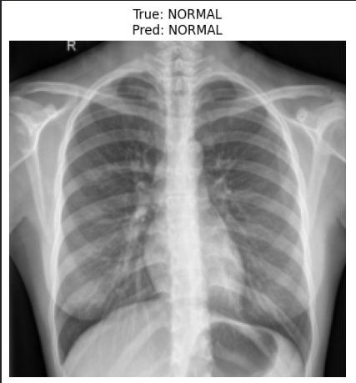
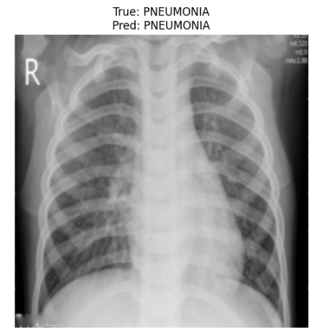
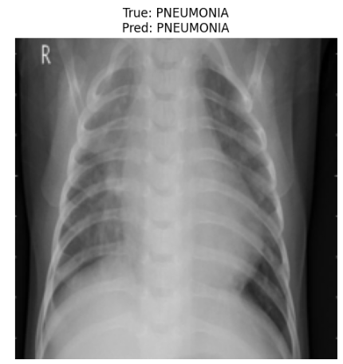
Inference Demo with Test Image Predictions
Real-Time Pneumonia Detection
The model performs real-time analysis of lung images to detect pneumonia quickly and accurately.
Model Practical Application
This demonstration highlights the practical use of AI in medical diagnostics through test image predictions.
Notes:
--- We demonstrate real-time pneumonia predictions on test images to showcase the model’s practical application and prediction capability. Image source: Microsoft 365 content library

Slide 16
Discussion, Limitations, and Future Steps
Notes:
In conclusion, we discuss the challenges faced, limitations of the current approach, and propose future improvements to enhance performance and reproducibility.

Slide 17

Challenges: Class Imbalance, No Pretrained Weights
Class Imbalance Issue
Class imbalance affects model performance by biasing predictions toward majority classes, reducing accuracy.
No Pretrained Weights
Training without pretrained weights requires more data and time, often resulting in lower model generalization.
Notes:
--- Key challenges include handling class imbalance in the dataset and training the model without pretrained weights, impacting accuracy and generalization. Image source: Microsoft 365 content library

Slide 18
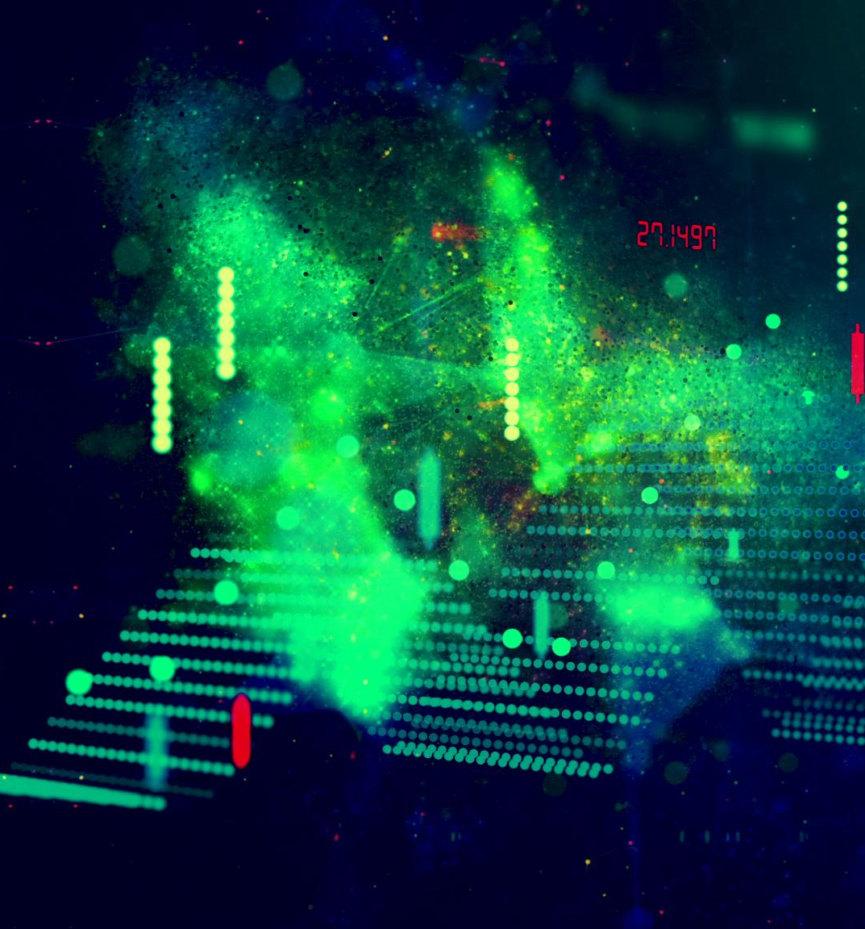
Proposed Improvements (Grad-CAM, Data Augmentation)
Grad-CAM Interpretability
Grad-CAM helps visualize model decisions by highlighting important input regions for better interpretability.
Data Augmentation Benefits
Data augmentation addresses dataset imbalance and enhances model robustness through synthetic data variations.
Notes:
--- Future work includes applying Grad-CAM for model interpretability and data augmentation techniques to address imbalance and improve robustness. Image source: Microsoft 365 content library

Slide 19
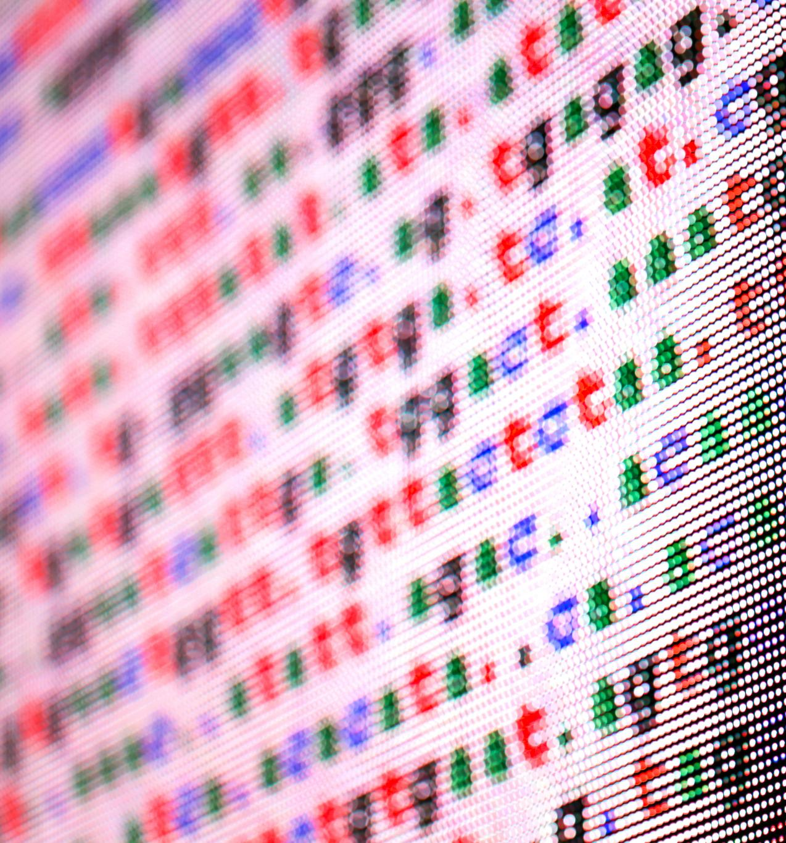
Reproducibility: GitHub Link, Modular Design, Video Demo
GitHub Repository Access
A GitHub repository is provided to enable easy access to project source code and version control.
Modular Code Structure
The project uses a modular code design to enhance readability, reuse, and maintainability.
Video Demonstration
A video demo is provided to guide users through the project setup and functionality.
Notes:
--- We ensure project reproducibility by providing a GitHub repository, modular code structure, and a video demonstration for easy replication and review. Image source: Microsoft 365 content library

Slide 20
Conclusion
Deep Learning Potential
Deep learning shows significant promise in accurately detecting pneumonia from chest X-ray images.
Project Challenges
Current challenges include data variability and ensuring reliable detection in diverse populations.
Future Enhancements
The project lays groundwork for improved algorithms and expanded clinical applications in pneumonia detection.
Notes:
This project demonstrates the potential of deep learning for pneumonia detection from chest X-rays, highlights challenges, and sets a foundation for future enhancements.

